Slide 1
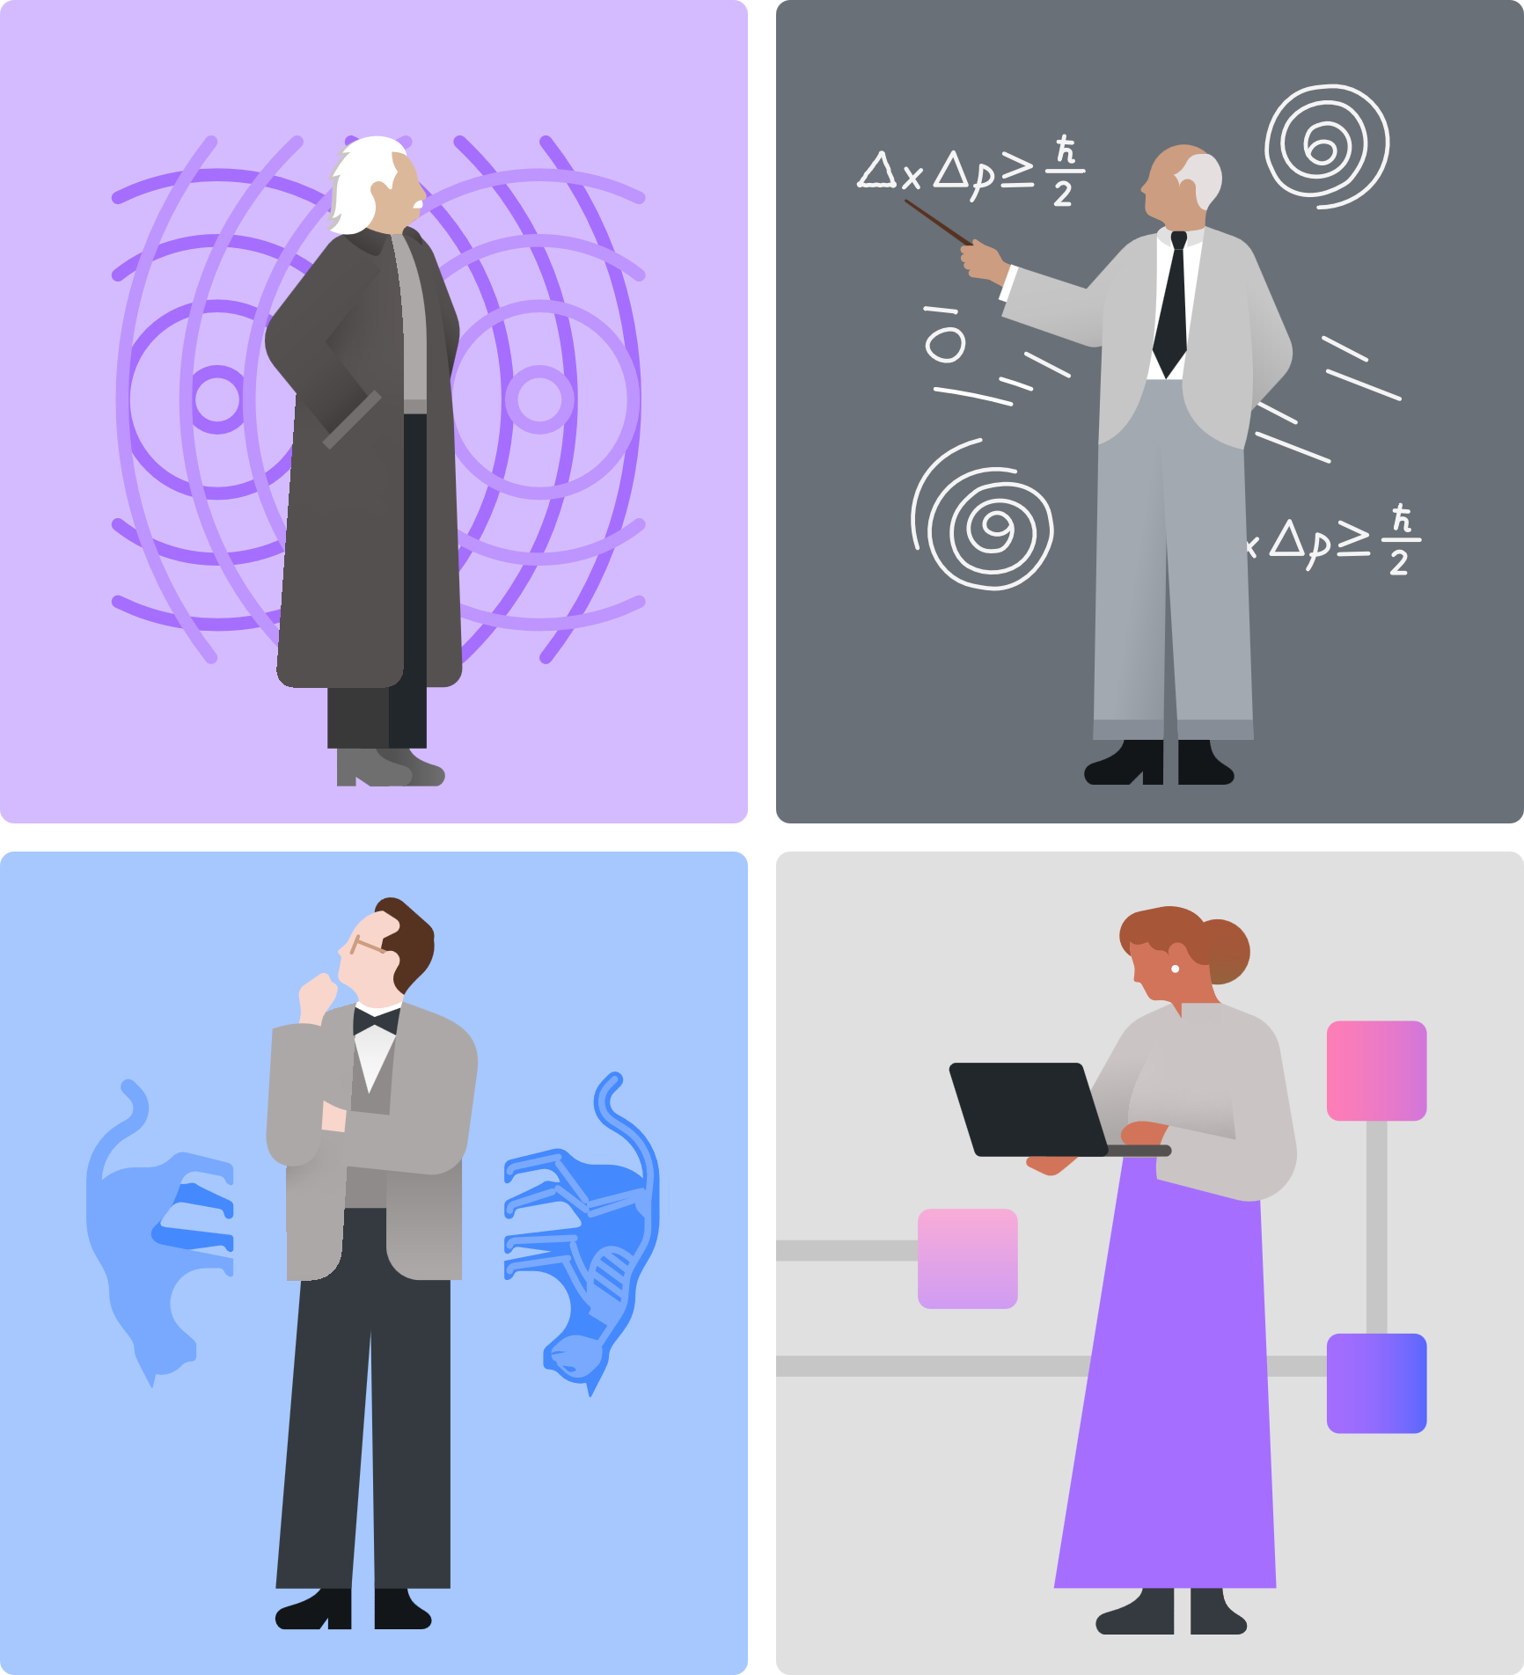
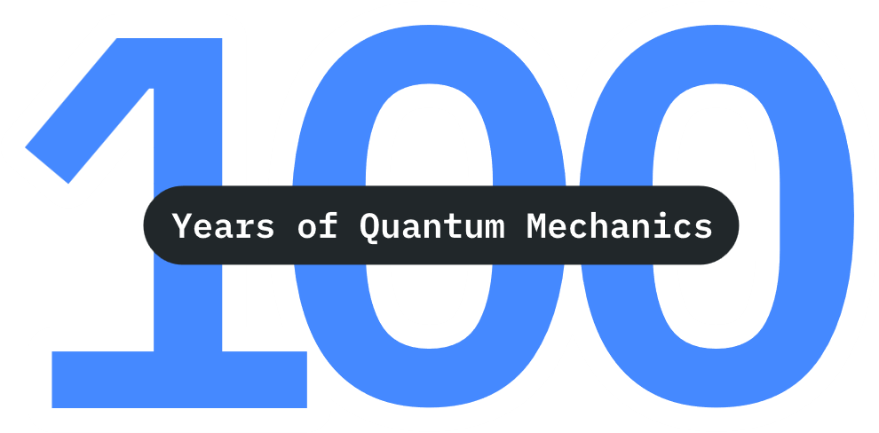
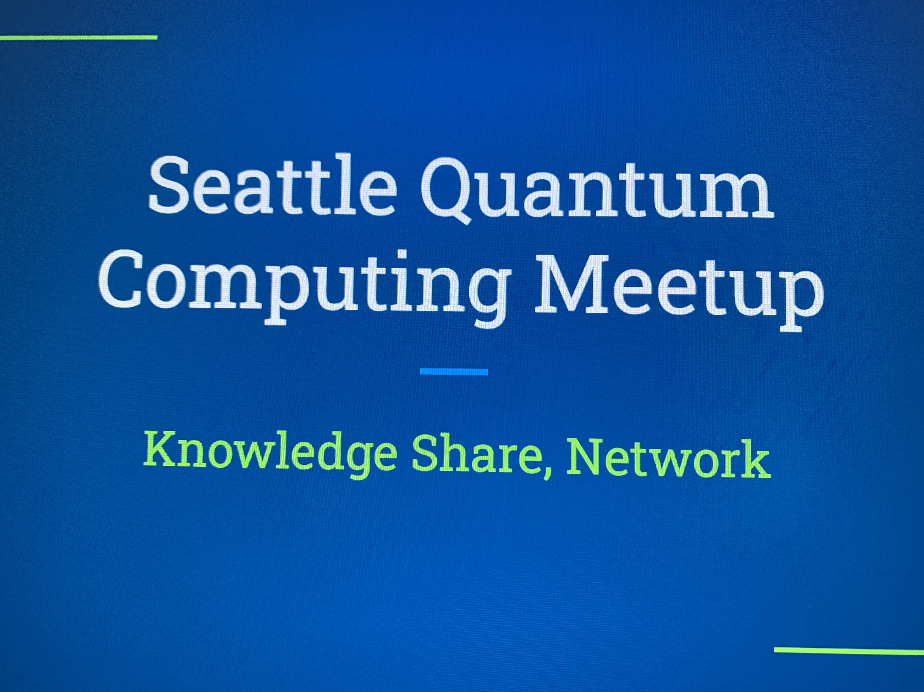


Qiskit Fall Fest 2025
Welcome, and
Happy IYQ!!!
Natalie Hawkins Qiskit Advocate
Seattle Quantum Computing Meetup, Founder

Slide 2

Today’s Agenda
Sat, Oct 4, 2025, 12:30pm-2:00pm
Qiskit Fall Fest 2025
What is it?
Who are the hosts?
SQCM FF25 Schedule
IBM Quantum, and others
IBM Hardware
IBM Roadmap
Quantum Computers
Quantum Programming
Qiskit
How to use it?
SQCM Fall Fest 2025 Activities
Coding Challenges
Hackathon Prompts
Open-Your-Choice Project
Quantum Games
Free Time

Slide 3
Qiskit Fall Fest – What is it?

Slide 4

Qiskit Fall Fest 2025
Qiskit Fall Fest is a collection of quantum computing events created and planned by university students and volunteer hosts, with support from IBM Quantum.
54 Sponsored Events
+ 89 Extension Events _
143 Total Events
https://www.ibm.com/quantum/events/fall-fest-2025
The Seattle Quantum Computing Meetup was selected as one of 150 universities or organizations to host a FF25, out of 600 applications.
https://github.com/SeattleQuantumComputingMeetup/qiskit_fall_fest_2025/tree/main

Slide 5
SQCM FF25 Schedule
Date | Time | Activity | Location
Sep 30 | 6-7:30pm PT | Fall Fest 2025 Prep - Qiskit and Quantum Computing 101 | Northgate Branch, Seattle Public Library
Oct 4 | 12:30-2:00pm PT | Qiskit Coding Challenges, Hackathon Prompts, Game Day | Montlake Branch, Seattle Public Library
Nov 3 | 10:00 am PT | Deadline for Coding Challenges and Hackathon Work | submit online
By Dec 1 | 11:59 pm PT | Participation and Winner Certificates Will Be Awarded | delivered online

Slide 6
IBM Quantum and Others – hardware and software

Slide 7
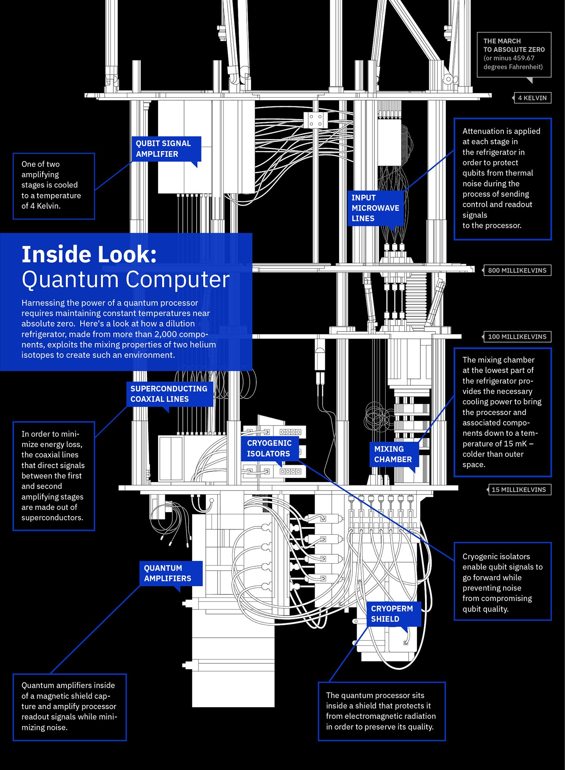
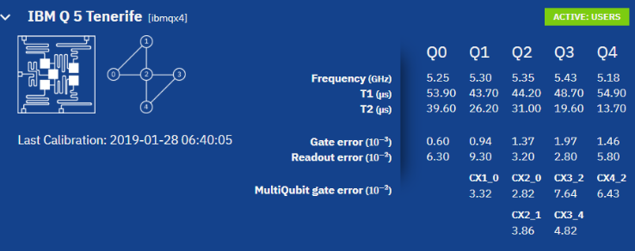
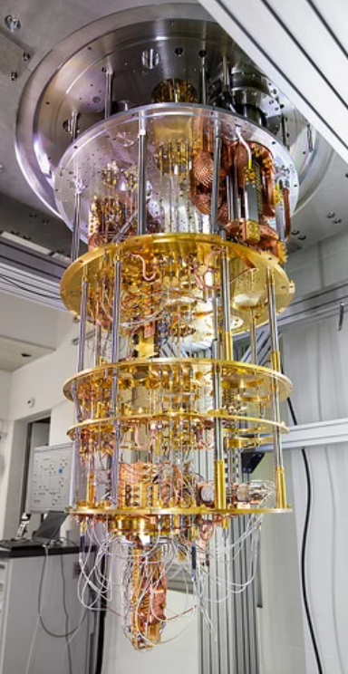
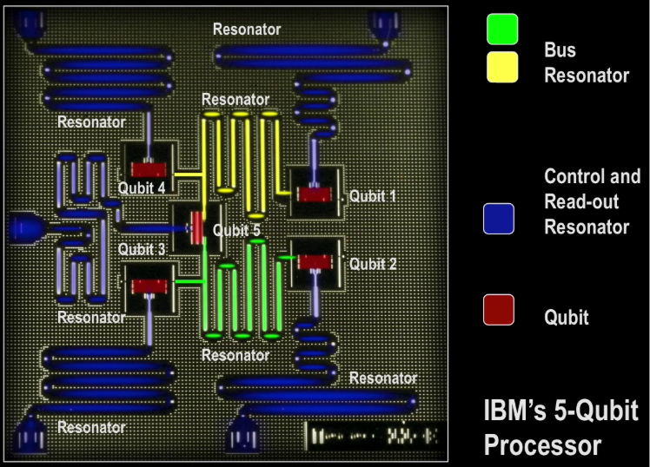
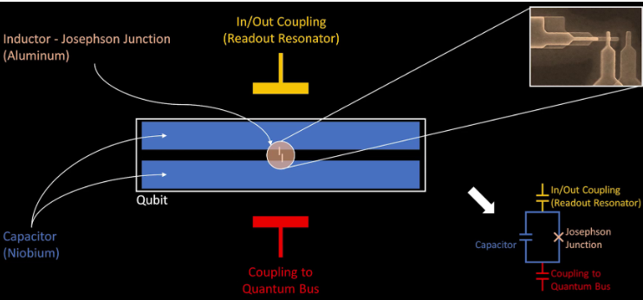
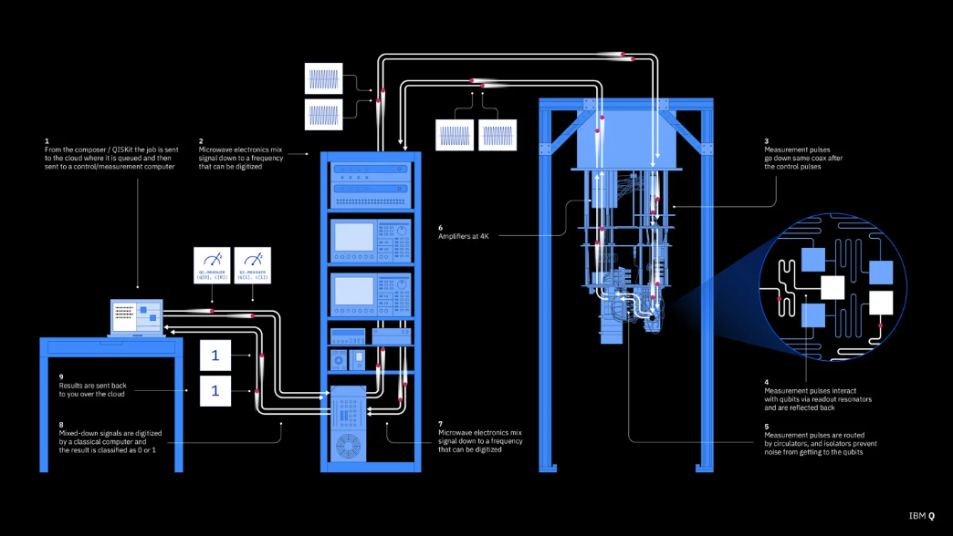
IBM Quantum, Hardware
The IBM Quantum Experience went live on May 4, 2016:
Superconducting Qubit with Josephson Junction (JJ):
QPU: size like CPU
Qubit: millimeters
JJ: microscopic (<= micrometers)
https://electronics360.globalspec.com/article/13553/how-quantum-computers-work

Slide 8
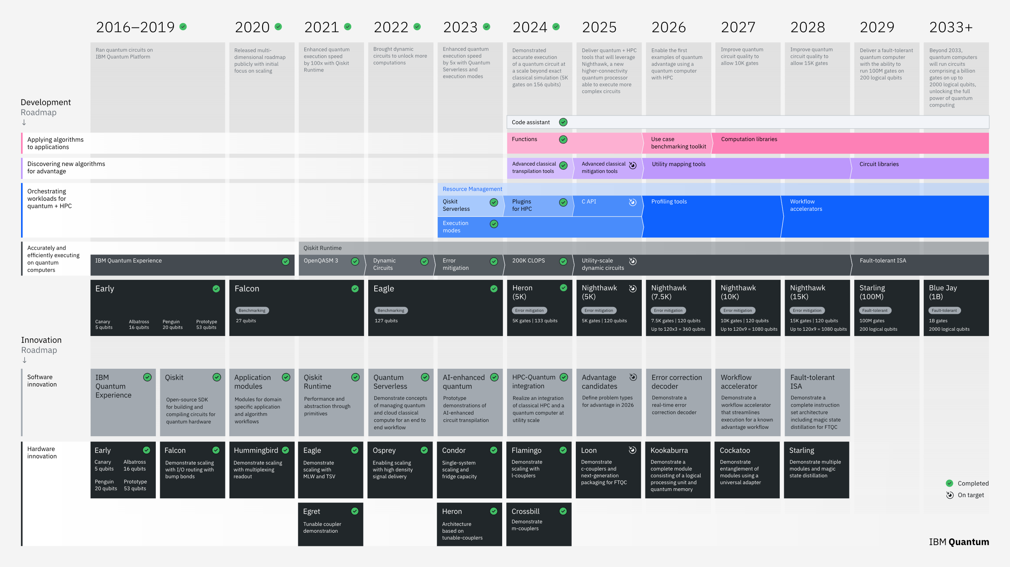
IBM Quantum, Roadmap
Diagram:
https://www.ibm.com/roadmaps/quantum/
Video:
https://www.ibm.com/quantum/technology#roadmap

Slide 9
What’s Out There?
Quantum Processors
Quantum Programming
“The development of quantum software has been strongly influenced by the open-source community, with many toolkits and frameworks—such as Qiskit, Cirq, PennyLane, and qBraid SDK—available under open licenses,” Wikipedia, Quantum Programming.
https://unitary.foundation/posts/2024_surveyresults/
There are different types of quantum processors:
Circuit-based quantum processors - QPUs are based on the quantum circuit and quantum logic gate-based model of computing. (e.g. IBM and others)
Annealing quantum processors - QPUs are based on quantum annealing, not to be confused with digital annealing. (e.g. D-Wave)
Analog quantum processors - These QPUs are based on analog Hamiltonian simulation. (e.g. QuEra)
https://en.wikipedia.org/wiki/List_of_quantum_processors
Quantum programming refers to the process of designing and implementing algorithms that operate on quantum systems, typically using quantum circuits composed of quantum gates, measurements, and classical control logic.
These circuits are developed to manipulate quantum states for specific computational tasks or experimental outcomes.
Quantum programs may be executed on quantum processors, simulated on classical hardware, or implemented through laboratory instrumentation for research purposes.
There are:
Quantum instruction sets (e.g. OpenQASM)
Quantum software development kits (e.g. Qiskit and others)
Quantum programming languages
https://en.wikipedia.org/wiki/Quantum_programming

Slide 10
Qiskit

Slide 11
How do I write and run Qiskit code?
Tools and Documentation
Online
Lab Environments
Google Colab is the easiest
qBraid is another option
https://quantum.cloud.ibm.com/docs/en/guides/online-lab-environments
Install Locally
in a Python environment
You can run your Qiskit code on your own computer.
https://quantum.cloud.ibm.com/docs/en/guides/install-qiskit
Jupyter Notebooks
This is the most common way to get started with Qiskit code.
You can upload your notebook, or start a new one, in Google Colab, for the easiest path as a Beginner.
Qiskit Documentation
The IBM Quantum Platform has Guides, an API Reference, Tutorials, and other Documentation.
https://quantum.cloud.ibm.com/docs/en/guides

Slide 12

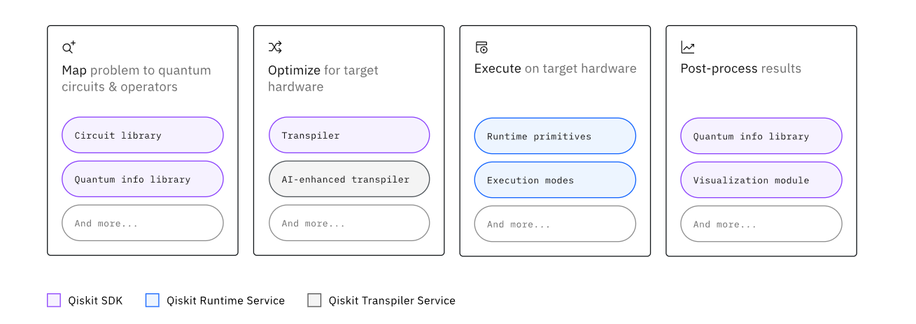
Qiskit Pattern:
The anatomy of a quantum algorithm – when ready to run on a backend
Qiskit Fall Fest 2025

Slide 13
Qiskit Pattern:
The anatomy of a quantum algorithm – when ready to run on a backend
How will you encode your data in a quantum state (angle, amplitude)? What qalg or subroutines will you use? ↓↓
Create an Instruction Set Architecture (ISA) circuit (native gates + SWAPs) ↓↓
Use the Sampler() or Estimator() Primitive to run a job ↓↓
Egs. result = job.result(), plot_histogram(counts) ↓↓
Example Backends: ↑↑ AerSimulator(), FakeTorino(), ibm_torino (Heron 133 QBs)
How will you test the code↑↑ that is producing these results?
Qiskit Fall Fest 2025

Slide 14
How do I learn more?
Edu Resources
Qiskit Guides / API Reference
Introduction to Qiskit
Install Qiskit
Qiskit Tools - such as Circuits and Operators, Transpiler, Debugging Tools, Primitives, Execution Modes, Manage jobs, IBM Quantum Computers
https://quantum.cloud.ibm.com/docs/en/guides
IBM Quantum Platform Learning
Free Online Classes, work at your own pace – Foundations, Focused topics, QC for business, Qiskit in classroom
https://quantum.cloud.ibm.com/learning/en
Qiskit Channel on YouTube
Topic videos – short and long
Seminar videos
Qiskit Global Summer School presentations and panels
Lab tours
https://www.youtube.com/qiskit
Qiskit-Community GitHub repos
qgss-2025
qiskit-machine-learning
qiskit-experiments
qiskit-optimization
qiskit-metal
https://github.com/qiskit-community
IBM Quantum Platform Tutorials
Hello world
Shor’s Alg
Grover’s Alg
QAOA Alg
Quantum kernel training
https://quantum.cloud.ibm.com/docs/en/tutorials
Qiskit v2.0
Developer Certification
Study Guide and Sample Test
Useful materials – whether or not you actually take the test
https://www.ibm.com/training/certification/ibm-certified-quantum-computation-using-qiskit-v2x-developer-associate-C9008400

Slide 15
SQCM Fall Fest 2025 Activities

Slide 16

Where are you on your Quantum journey?
0
Beginner - Intermediate
5
10
What’s Quantum?
Reading, Videos, Science, math or hands-on coding
Papers, Active Research and development
Qiskit Fall Fest 2025

Slide 17
What are the project options?
Qiskit Coding Challenges
Hackathon Prompts
Define your own project –
You can create a project on a topic of your own choosing, related to Quantum Computing.
This could be a hackathon-like prompt, an idea for a start-up, an article or essay or piece of creative writing, an idea for a game, a type of art of any form, or any other suggestion you might have; the sky’s the limit!
If you’re interested in defining a business, or some other type of business challenge, you can look at this page from the fall fest we hosted last year: https://dorahacks.io/hackathon/564/businesschallenge
Have fun!
Beginner Notebook – Qiskit 2 Fundamentals Lab, This notebook is designed to help you get up to speed on Qiskit 2 fundamentals by providing hands-on exercises for 18 core concepts. As a bonus, in the last cell, you can run code on real IBM quantum hardware!
Intermediate Notebook – Hands-On Introduction to DiVincenzo Criteria with Qiskit 2, Physicist David DiVincenzo outlined five key requirements for any physical implementation of a quantum computer, plus two additional criteria for quantum communication. In this notebook, we will experience each DiVincenzo criterion through practical Qiskit demonstrations. You will get to run circuits on simulators and real IBM Quantum devices to explore each principle hands-on.
https://github.com/SeattleQuantumComputingMeetup/qiskit_fall_fest_2025/tree/main/coding_challenges
Cleveland Clinic – protein structure prediction
BasQ – quantum Battleship/BombTester game
Mila – financial application, options pricing
Rensselaer PTI – cryptography/Quantum Key Distribution
https://github.com/SeattleQuantumComputingMeetup/qiskit_fall_fest_2025/tree/main/hackathon_prompts

Slide 18
How do I earn a certificate from IBM Quantum?
Participation Certificate
Winner Certificate
Do one of the following:
Attend at least one in-person SQCM FF25 event
Complete the Beginner or Intermediate Notebook
Do one of the following:
Complete both the Beginner and Intermediate Notebooks
Submit work on one of the Hackathon prompts
Submit work on a topic of your own choosing related to Quantum Computing. This could be a hackathon-like prompt, an idea for a start-up, an article or essay or piece of creative writing, an idea for a game, a type of art of any form, or any other suggestion you might have; the sky’s the limit! Have fun!
Submit your work by sending a direct message in Discord (nhawkins), Meetup (Natalie Hawkins), or LinkedIn (natalie-hawkins-seattle) or an email to nrhawkins@gmail.com with ONE of the following, as well as indicating your full name as you wish it to appear on the certificate:
a link to a github repo or other storage location, like Box, containing your work
attach your file(s) to the message

Slide 19
How do spend the rest of my time today at the SQCM FF25 Kickoff?
1
Start working on the Beginner Notebook. Choose a path of uploading the notebook to an online lab environment or create a Python environment on your own machine and install Qiskit.
2
Join the SQCM Discord. Network with others, to see what they’re interested in.
Find the Discord invite link under the About tab on:
https://www.meetup.com/seattle-quantum-computing-meetup/
3
Read through the Hackathon Prompts, if that path interests you, or brainstorm on a topic of your own choice.
4
Try out the board game Entanglion, created by IBM Quantum Researchers, or the digital QC game, Qpong, created by Junye Huang, Technical Integrations Engineer at IBM Quantum.
https://www.lexaloffle.com/bbs/?tid=39762

Slide 20
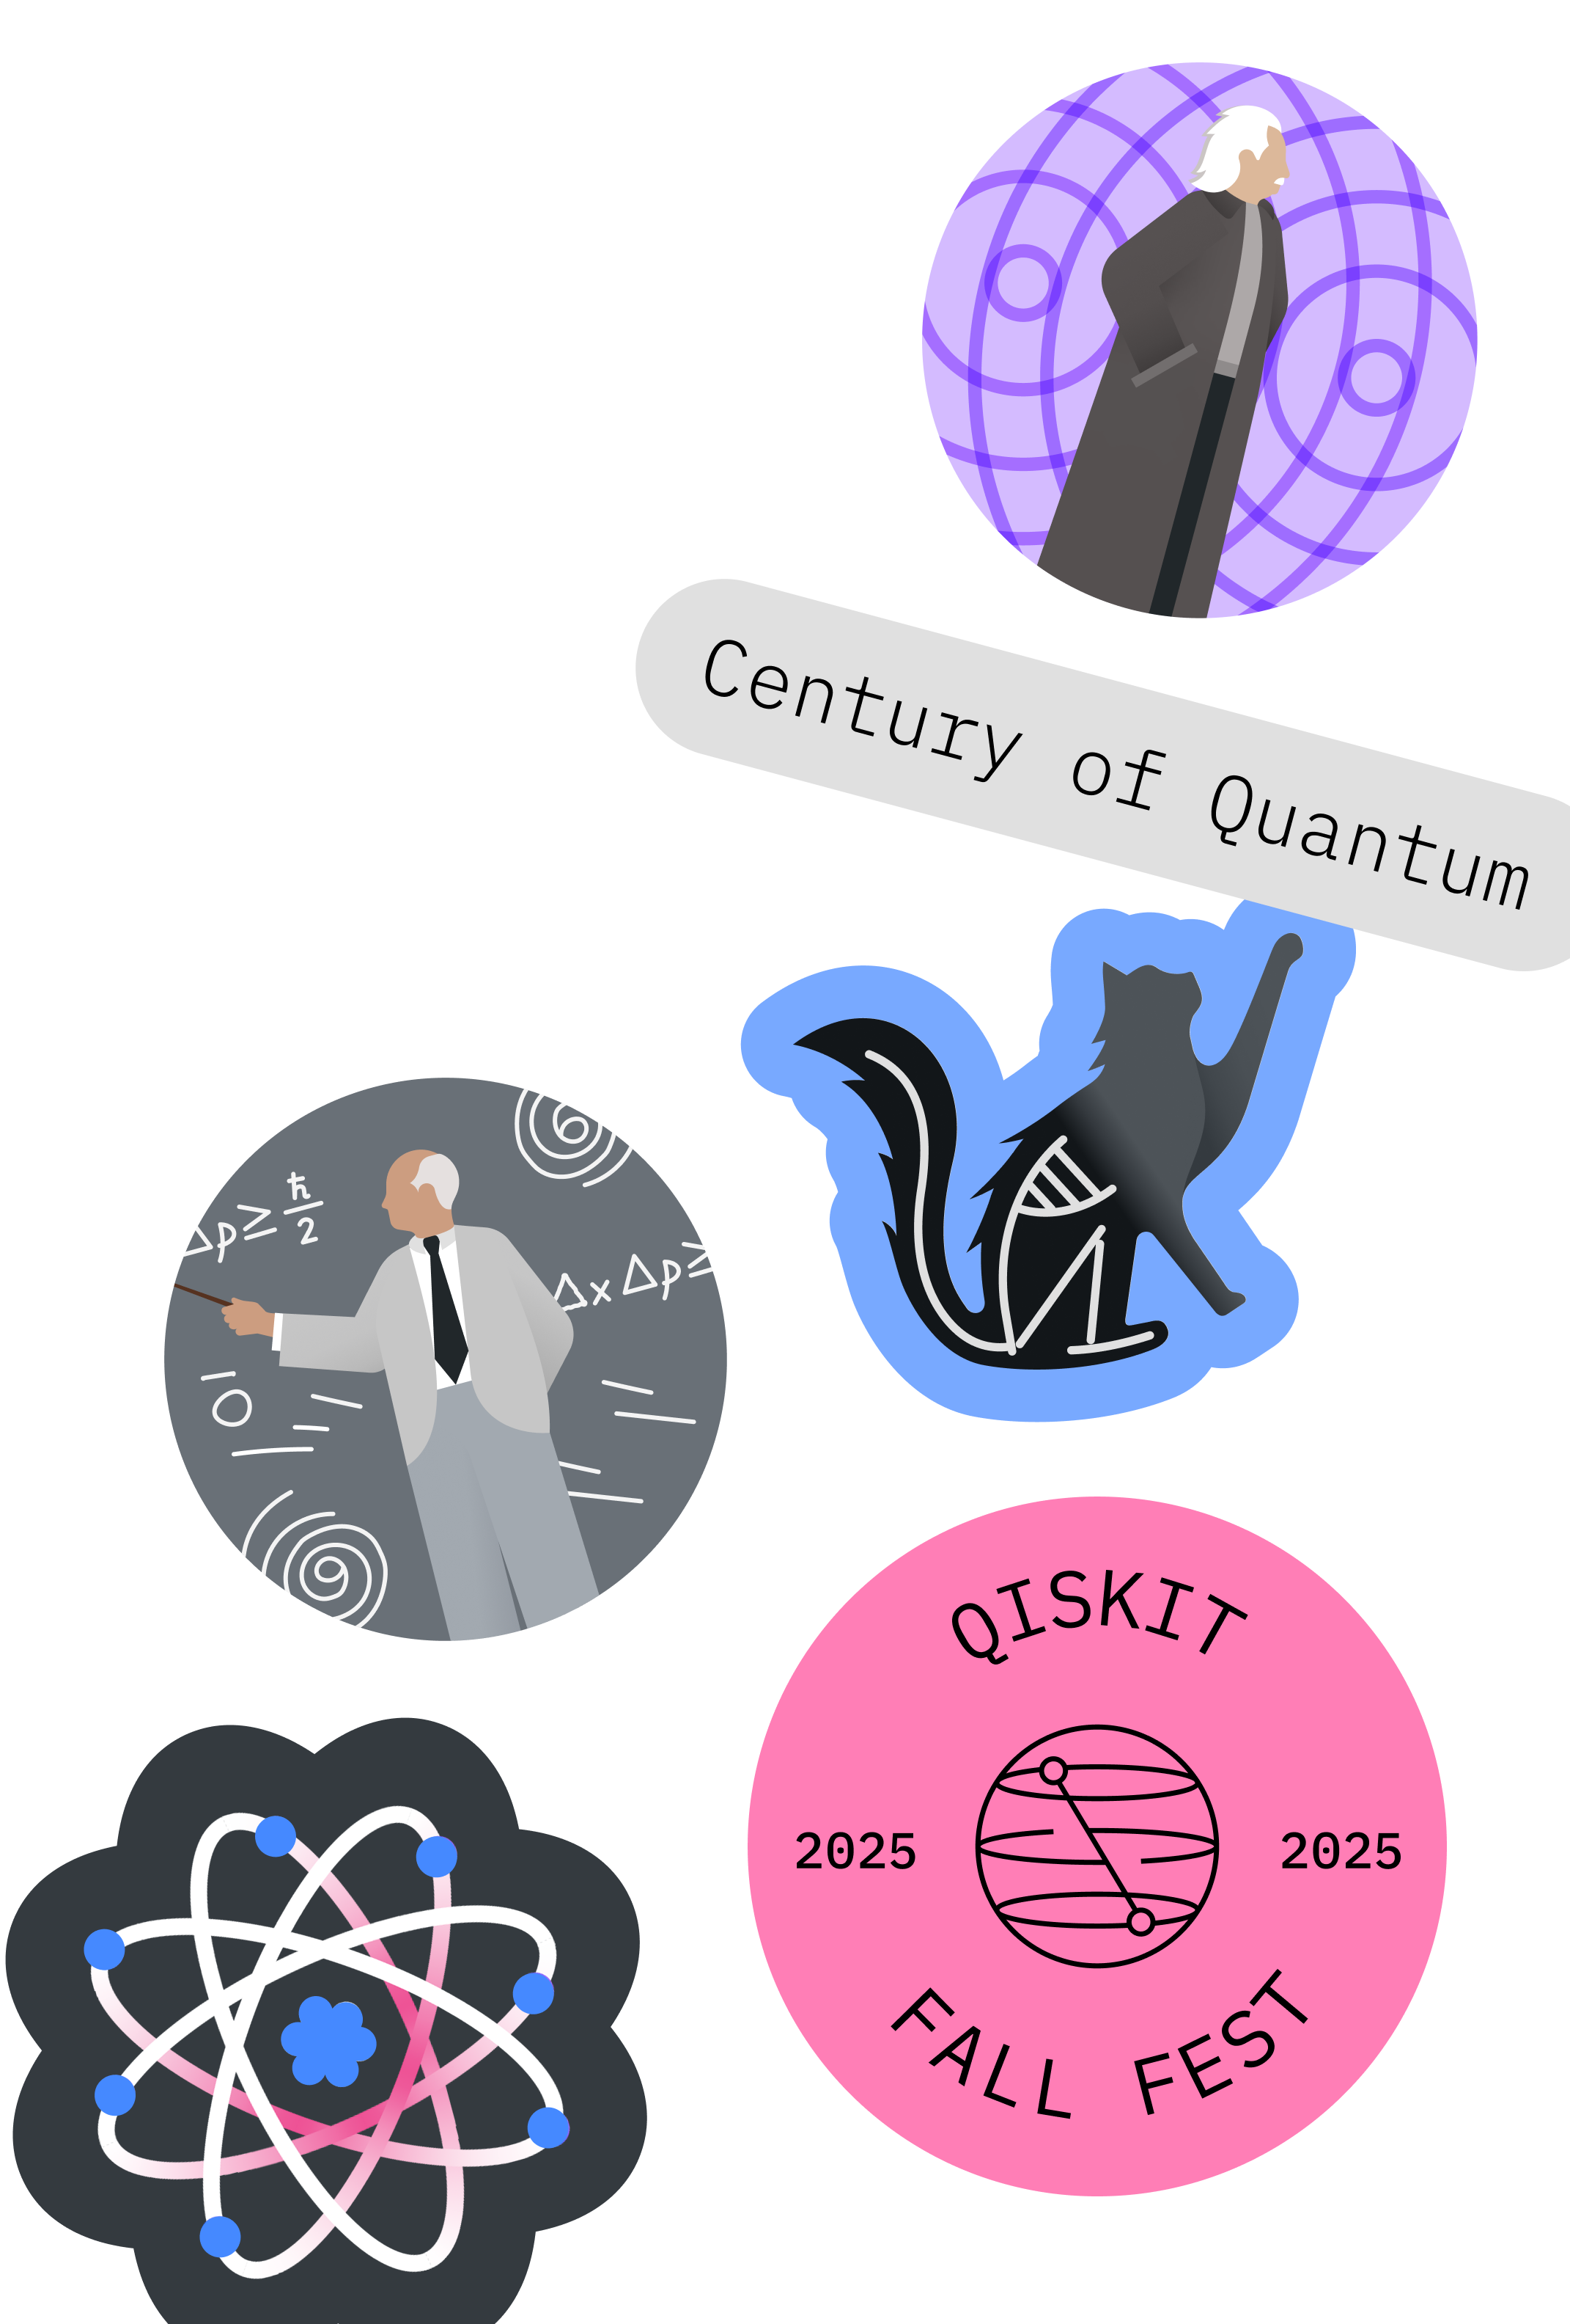
Qiskit Fall Fest 2025
Thanks for Joining the SQCM Qiskit Fall Fest!!

